Slide 1
Inventory Management System
By Parth Patel

Slide 2
Introduction
With this project I was tasking with creating an inventory management system with Java having the capability to manipulate a mySQL database.
Overview:
Jira Board
Designed my own GCP instance
Added customers, items, and orders

Slide 3
Consultant Journey
Git
Jira
GCP
SQL
Java
Junit
Mockito

Slide 4

CI-How did I approach version control?
Originally I used a master/dev/feature<x> branch model
Master
Where all the final work is compiled to
Dev
Feature
Used for adding and updating specific features

Slide 5



Testing

Slide 6
Here’s how the system will work!

Slide 7
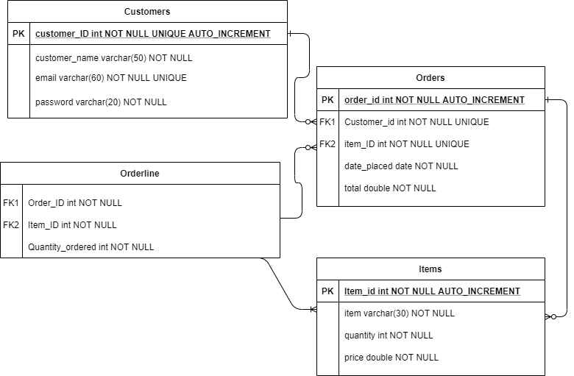

Slide 8
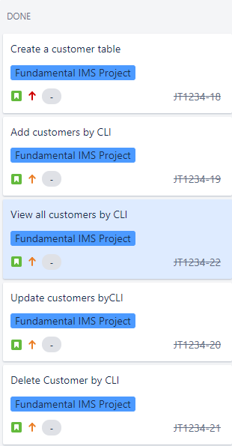
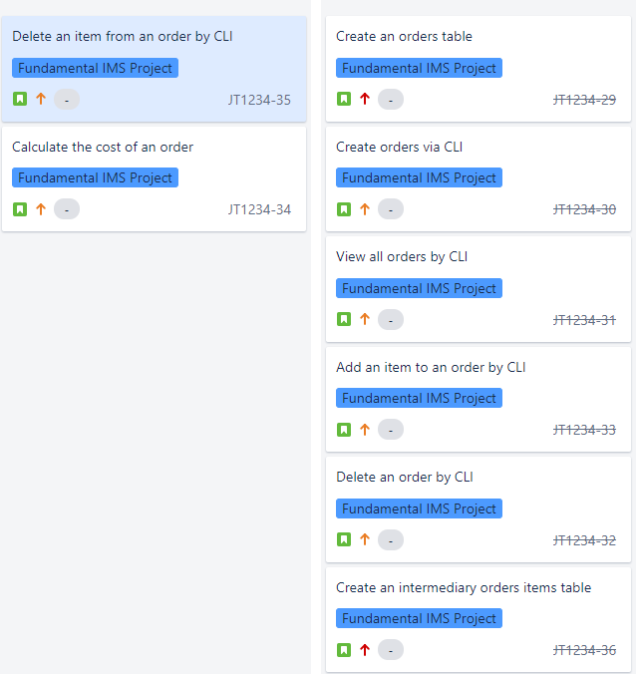
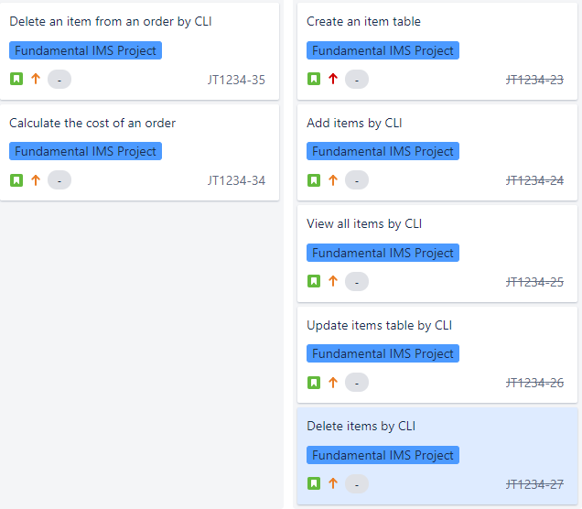
Sprint Review

Slide 9
Sprint Retrospective
SQL
Time management
Asking for help

Slide 10
Conclusion
What went well?
Designing the SQL database
Most of the Crud functions
Testing
What I can improve?
Not having an Orderlines class
Time management
More practice on my own time

